Slide 1
Tableau Hands-On Fundamentals of Tableau Basic Charts
Alejandro Gutierrez Lopez
Nabil Beitinjaneh
Special thanks to Tableau who provided training material
Please do not forward on or share without the approval of nabil.beitinjaneh@mcgill.ca

Slide 2
Bar Charts
Notes:
Section Header

Slide 3
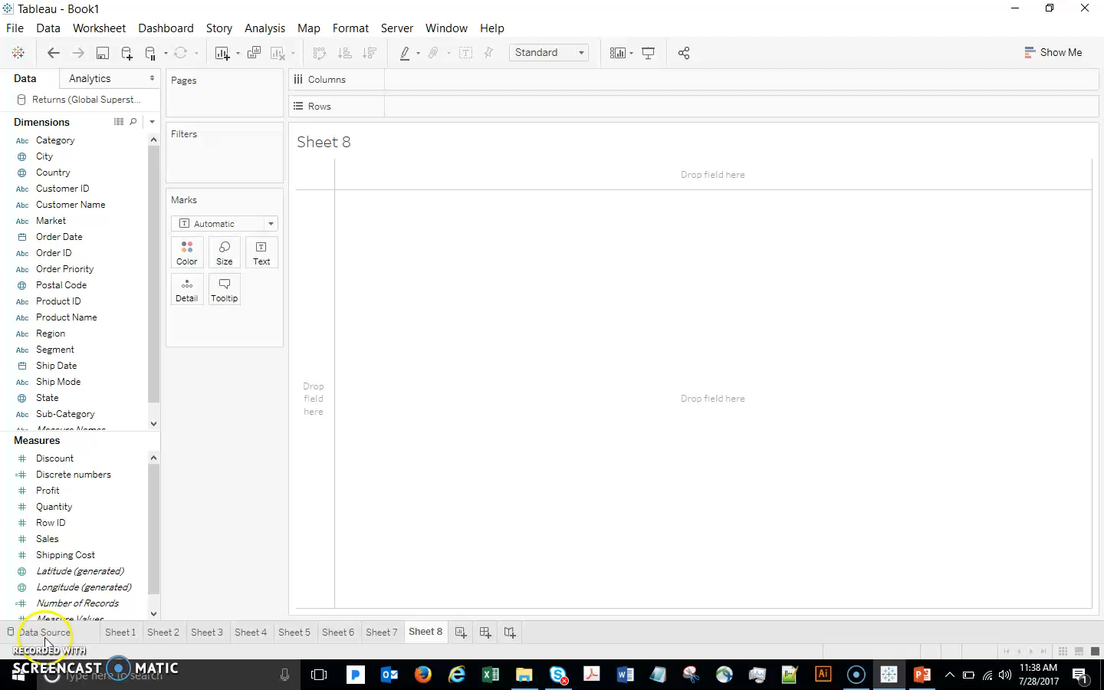
Bar Charts
Notes:
Narration :
We have already created some bar charts, but now let’s dive more deeply into this very simple but very powerful chart type.
Let’s Analyze Sales (double click) by Category (double click) and drill down to Sub-Category (drag to Columns, left of Category).
To make this easier to read let’s rotate it (click Swap in the toolbar) and sort it (click Sort icon).
This gives me a sorted view of Sales (in just a few seconds!). For example, Furniture (especially Chairs) seems to be selling well.
But what about Profits?
Note that there is more than one way to get to this visualization using different approaches. You may want to experiment before moving on.

Slide 4
Bar Charts
Let’s Analyze Sales (double click) by Category (double click) and drill down to Sub-Category (drag to Columns, left of Category).
To make this easier to read let’s rotate it (click Swap in the toolbar) and sort it (click Sort icon).
This provides us a sorted view of Sales by Sub-Category.
For example, Furniture (especially Chairs) seems to be selling well.
What about Profits?
Notes:
We have already created some bar charts, but now let’s dive more deeply into this very simple but very powerful chart type.

Slide 5
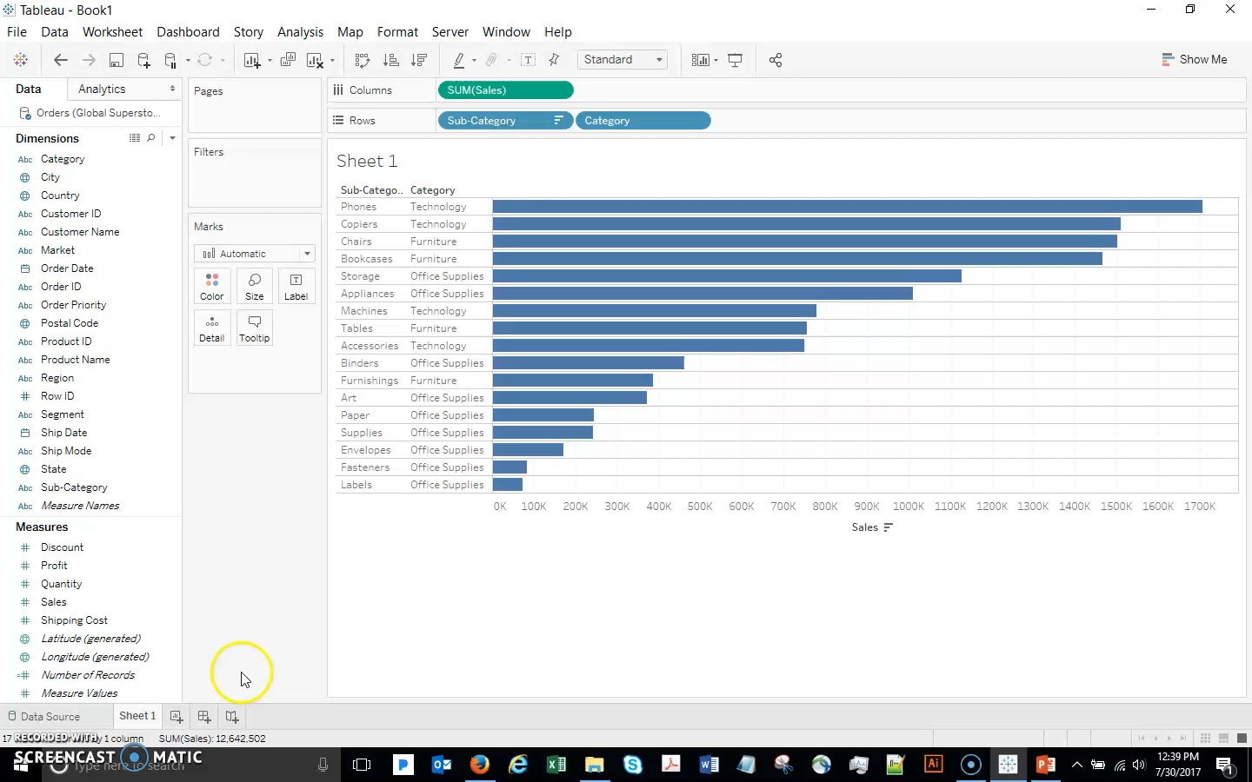
Bar Charts
Drag Profit out so you get the “show me” cursor. Drop it and Tableau will use it on the Color shelf. It’s clear that Tables are not profitable – and Global Superstore is selling lots of them! Not good.
Notes:
Narration:
Now let’s look at Profits
Drag Profit out so you get the “show me” cursor. Drop it and Tableau will use it on the Color shelf. It’s clear that Tables are not profitable – and Global Superstore is selling lots of them! Not good.

Slide 6
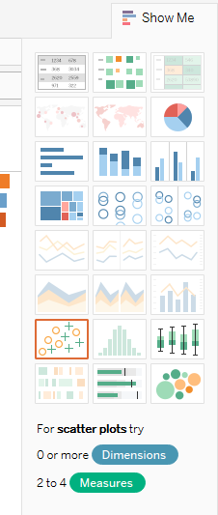
Bar Charts
The Show Me pane provides other possibilities for visualizing the data we have selected,
Experiment by clicking a couple of options to see what happens,
When done experimenting, use the Back button to return to our bar chart.
Notes:
Narration:
The Show Me pane provides other possibilities for visualizing the data we have selected,
Experiment by clicking a couple of options to see what happens,
When done experimenting, use the Back button to return to our bar chart.

Slide 7
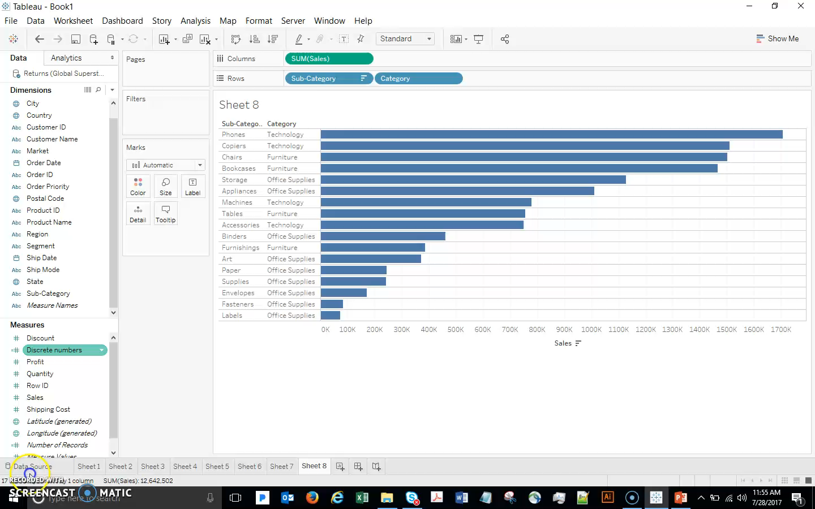
Bar Charts – Group and Create Alias
Notes:
Narration:
Given the number of categories, we may want to “group” some of them to make the visualization easier on the eye (less is better usually). Then zoom down on one product to explore and understand the sales data.
Notice that Office Supplies has a number of smaller categories that are just cluttering up our analysis. This is a common issue in a dataset, and we should not remove these small categories because they may be significant in the aggregate.
Instead, let’s select them all (hold down CTRL and select the words you want to group),
When they are all selected, click on the paper clip to Group them.
Now Right-click and Edit Alias to rename the group.
It is important to understand that this does not change the underlying data – the original sub-categories are still there. What this HAS done is created a new object (check it out in the dimensions pane).
Now we see that there is a problem in Tables. Right-click Tables and select Keep Only.
Now that we’re just looking at Tables, let’s drill all the way down to the Product level.
Drag out the Product Name to the viz and,
Sort descending.
Finally let’s look at the actual underlying data from our top selling product here.
Click the first bar… View Data, Full Data tab.
Now we have a nice list of transactions that we might want to investigate further to understand the issues. This is called exploratory analysis.

Slide 8
Bar Charts – Group and Create Alias
let’s select the Office Supplies categories (hold down CTRL and select the words you want to group),
When they are all selected, click on the paper clip to Group them.
Now Right-click and Edit Alias to rename the group.
It is important to understand that this does not change the underlying data – the original sub-categories are still there.
Now we see that there is a problem in Tables. Right-click Tables and select Keep Only.
Now that we are just looking at Tables, let’s drill all the way down to the Product level.
Drag out the Product Name to the viz and,
Sort descending.
Finally let’s look at the actual underlying data from our top selling product here.
Click the first bar…
View Data, Full Data tab.
And now I have a nice list of transactions that I might want to investigate.
Notes:
Narration:
Just in case, these are the steps to follow to replicate the previous simulation.

Slide 9
Scatterplots
Notes:
Section Header

Slide 10
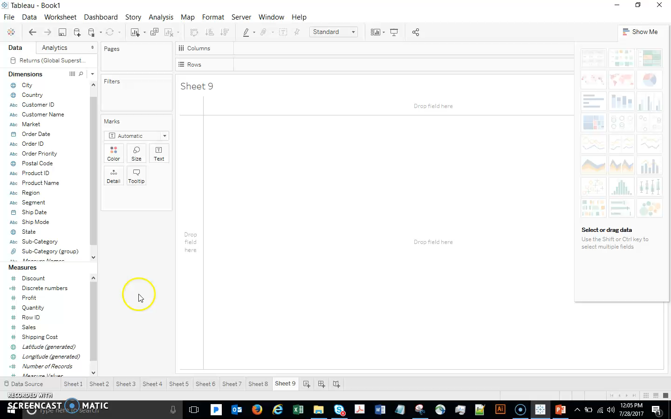
Scatterplots
Notes:
Narration:
Scatterplots are a very easy and powerful way to visualize the relationships between numeric variables (Measures). For example, I wonder if there is a relationship between Discount and Profit (seems like a reasonable possibility). Let’s take a look by :
First selecting those two fields (by selecting and holding the Control key) and,
clicking Scatterplot on the Show Me menu.
Go to Analysis, uncheck Aggregate Measures. (this is an important step that you will have to do regularly as Tableau will aggregate by default)
Swap if needed to get Discount on the horizontal axis
What do you think? It looks like Profit tends to decrease as a larger Discount is given (which confirms our intuition).
Remember that with Tableau, unlike many other tools, we don’t need to stop here. It is very easy to keep adding data.
For example, drag Segment to Color. This makes it easy to see what segment certain outliers belong to.
If we prefer to focus on just one segment (while leaving all the data displayed), we can:
Click Highlight Selected Values in the Legend and select, for example, to focus our viz on the Corporate segment by highlighting it.
Go back to viewing all the data.
Go to the Analytics pane and drag out a trend line (choose linear).
This is a regression line. Regression (at a basic level) will be covered elsewhere in the course.
This trend line does not look very impressive, but take a look at the y-axis scale. We need to investigate more before dismissing this as a negligible relationship.
Hover over the trend line. The p-value is very small, so in fact the relationship between these variables is statistically significant. And we can see by the negative coefficient that the relationship is negative. However, the R-Squared value is somewhat low, so our simple trend line has not explained very much of the relationship.
. Drag the trendline out of the viz to remove it.

Slide 11
Scatterplots - Steps
Scatterplots are a very easy and powerful way to visualize the relationships between numeric variables (Measures). For example, is there is a relationship between Discount and Profit?
First select the Discount and Profit fields (by selecting and holding the Control key and the same time) and,
Click Scatterplot on the Show Me menu.
Go to Analysis, uncheck Aggregate Measures. (this is an important step that you will have to do regularly as Tableau will aggregate by default)
Swap to get Discount on the horizontal axis
It looks like Profit tends to decrease as a larger Discount is given.
For example, drag Segment to Color. This makes it easy to see what segment certain outliers belong to.
If we prefer to focus on just one segment (while leaving all the data displayed), we can:
Click Highlight Selected Values in the Legend and select, for example, to focus our viz on the Corporate segment by highlighting it.
Go back to viewing all the data.
Go to the Analytics pane and drag out a trend line (choose linear).
This is a regression line. Hover over the trend line.
Drag the trendline out of the viz to remove it.
Notes:
To finish, we want to leave you with the following quote “She/He who jumps into the void owes no explanation to those who stand and watch”.

Slide 12
Line Graphs
Notes:
Section Header

Slide 13
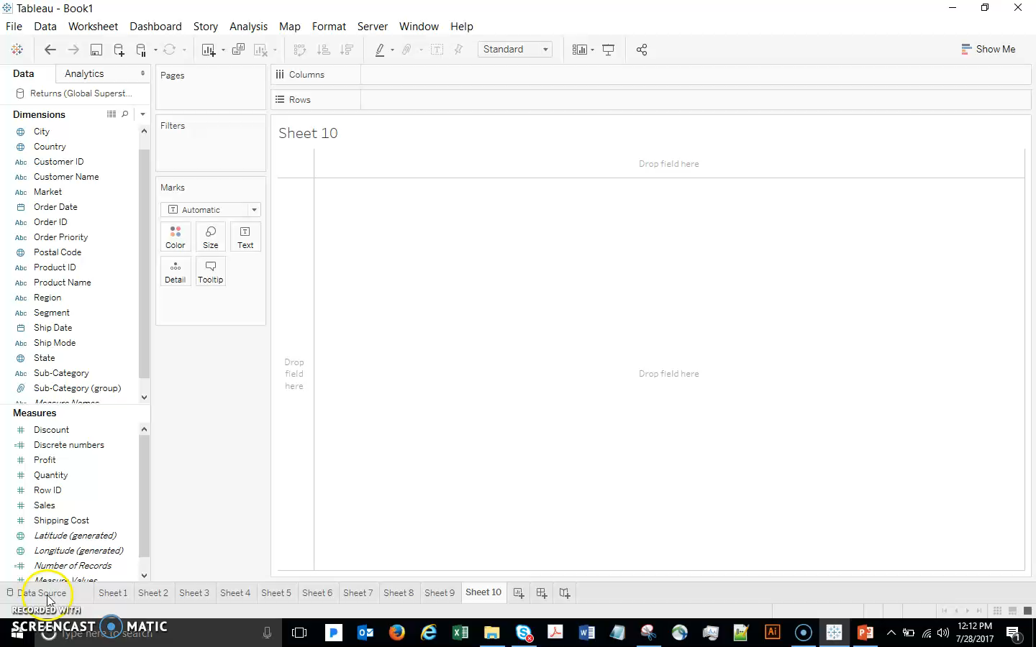
Line Graphs
Notes:
Narration :
Like Scatterplots, line graphs are good for looking at the relationship between 2 variables (although a scatterplot is often better for this). Line graphs are often used for looking at how something changes over time. This is called time series analysis.
Let’s start by looking at sales over time. Double-click Sales, then double-click Order Date.
Tableau understands date fields and automatically breaks them down by Year, Quarter, etc.
If we need more detail than yearly sales results, let’s expand to Quarter and then Month.
We do not care about Quarter, so drag it out of the viz.
Note that dual axis is very easy in Tableau – drag Profit to the right axis. Then Undo to get back to Sales only.

Slide 14
Line Graphs - Steps
Line graphs are often used for looking at how something changes over time. This is called time series analysis.
Let’s start by looking at sales over time.
Double-click Sales,
double-click Order Date. Tableau understands date fields and automatically breaks them down by Year, Quarter, etc.
Expand to Quarter and then Month.
Drag Quarter out of the viz.
Drag Profit to the right axis to get a dual axis.
Then Undo to get back to Sales only.
Notes:
Narration :
Step by step process

Slide 15
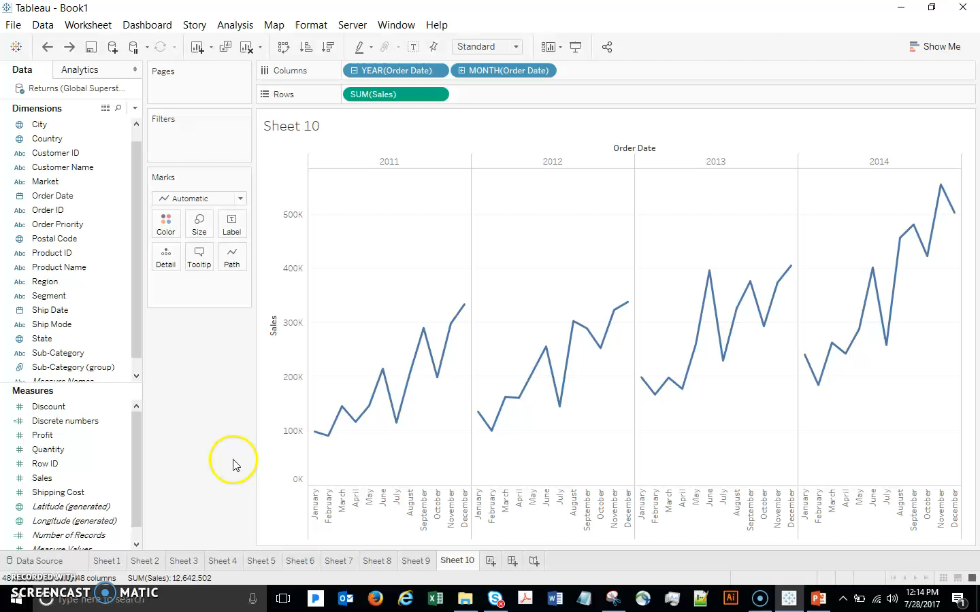
Line Graphs – Discrete Dates
Notes:
Narration:
Remember that we can now drag things around and change the viz on the fly.
We have discrete dates right now (we have already learned how, with discrete dates, each part of the date is treated separately).
So for example we can drag Year to Color and see direct comparisons between the years.
(Note that, if you liked the current format and just want each year to be a different color for clarity, you could Control-drag Year to color).

Slide 16
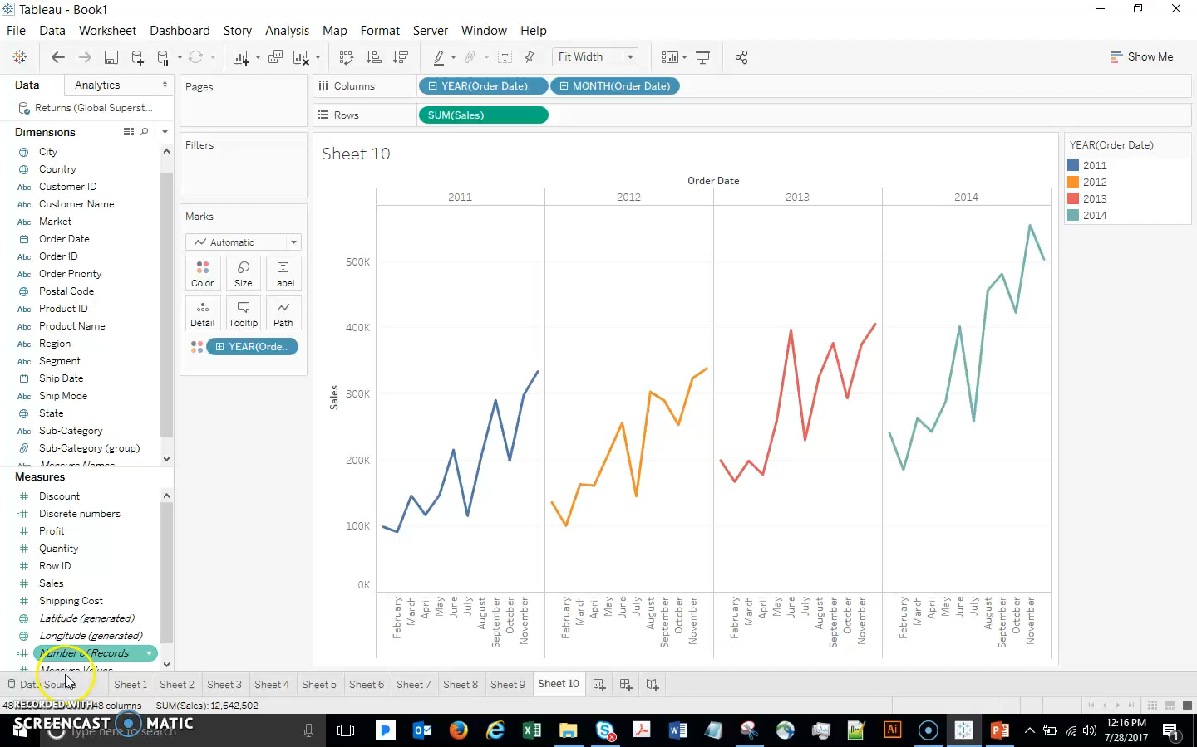
Line Graphs – Table Calculations
Notes:
Narration:
Let’s all get back to a separate line chart for each year.
Ifwe want to look at a common calculation for time series data, like year over year growth, it is very easy:
Click on the green Sum(Sales) pill.
Select Quick Table Calculation… Year over Year Growth.
Now I can see that there were months in which sales went down YOY.
Click the Back button.

Slide 17
Line Graphs – Table Calculation Steps
If I want to look at a common calculation for time series data, like year over year growth, it is very easy:
Click on the green Sum(Sales) pill.
Select Quick Table Calculation… Year over Year Growth.
Now I can see that there were months in which sales went down YOY.
Click the Back button.

Slide 18
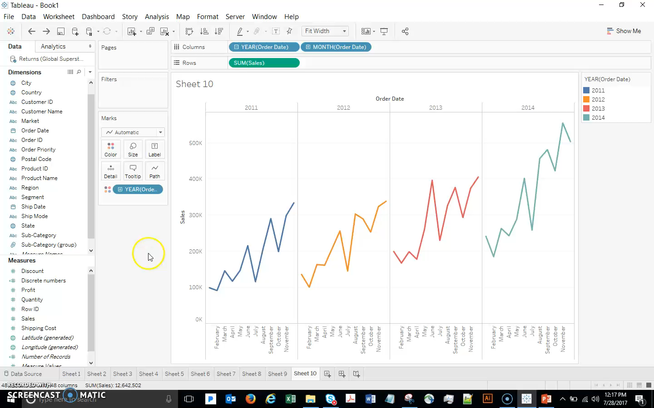
Line Graphs - Forecasting
Go to the Analytics pane and drag out Forecast. Then Click the Back button.
Notes:
Narration:
Tableau provides you with forecasting abilities.
Go to the Analytics pane and drag out Forecast. Then Click the Back button.

Slide 19
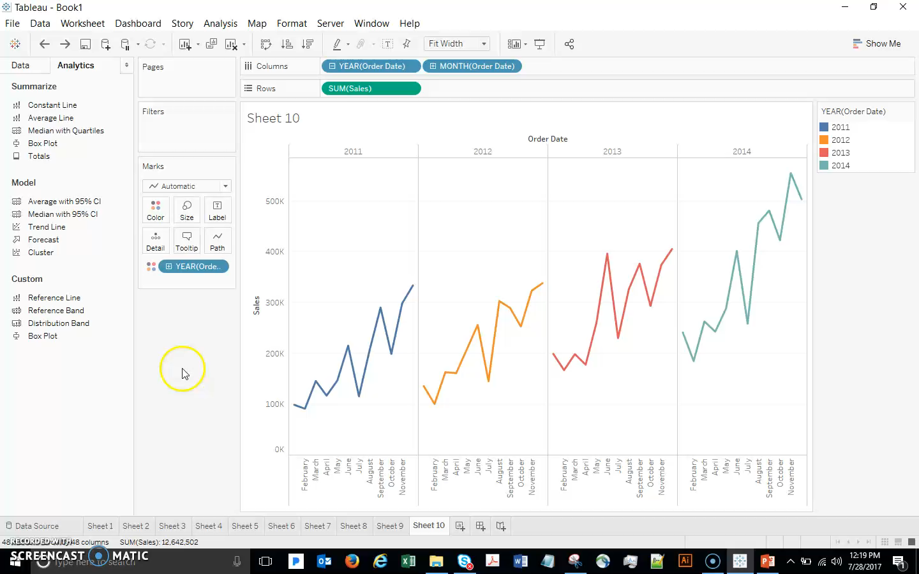
Line Graphs – Reference Lines
Drag the Average Line onto the viz…drop it onto the Pane icon.
Select a few points in the line graph and note the new average line.
Notes:
Narration:
Another useful feature to add to a line chart is a reference line, for example:
Drag the Average Line onto the viz…drop it onto the Pane icon.
On can also drill down to a couple of point and this average will dynamically adjust:
select a few points in the line graph and note the new average line.

Slide 20

From Line Graphs to Other Visualizations
Notes:
Narration:
Although we are talking about line graphs, it is easy to explore other options:
click the drop-down in the Marks card and select Bar,
then Circle, and
then finally leave it as Area.

Slide 21
Histograms
Notes:
Section Header

Slide 22
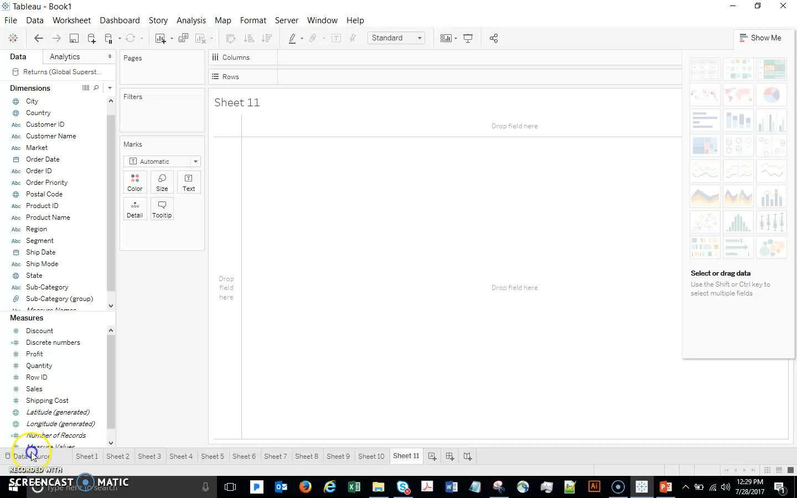
Histograms
Notes:
Narration:
Double click Discount.
The default is a bar chart, and we can add more data to break out discount by segment, etc. But what if we are just interested in learning more about the various discounts that we offer?
Use Show Me to change to Histogram.
Right-click the new Discount(bin) dimension,
Edit, and change bins to 0.1.
This is a very quick and easy way to get the view of the data that we want! Now we can see that most discounts are between 0 and 10%, and there are also a lot of discounts in the 10-20% range. We even have 300 instances in which the discount given was 70-80% (shown in the Tooltip). If we are suspicious about these, it just takes a couple clicks to get to the underlying data
right-click that bar and show the data
We can add more data if we want – for example, we can see a breakdown by Category
drag Category to Color,
then Undo this change.

Slide 23
Histograms - Steps
Double click Discount.
Use Show Me to change to Histogram.
Right-click the new Discount(bin) dimension,
Edit, and change bins to 0.1.
right-click that bar and show the data
drag Category to Color,
then Undo this change.

Slide 24
Heat Maps
Notes:
Section Header

Slide 25
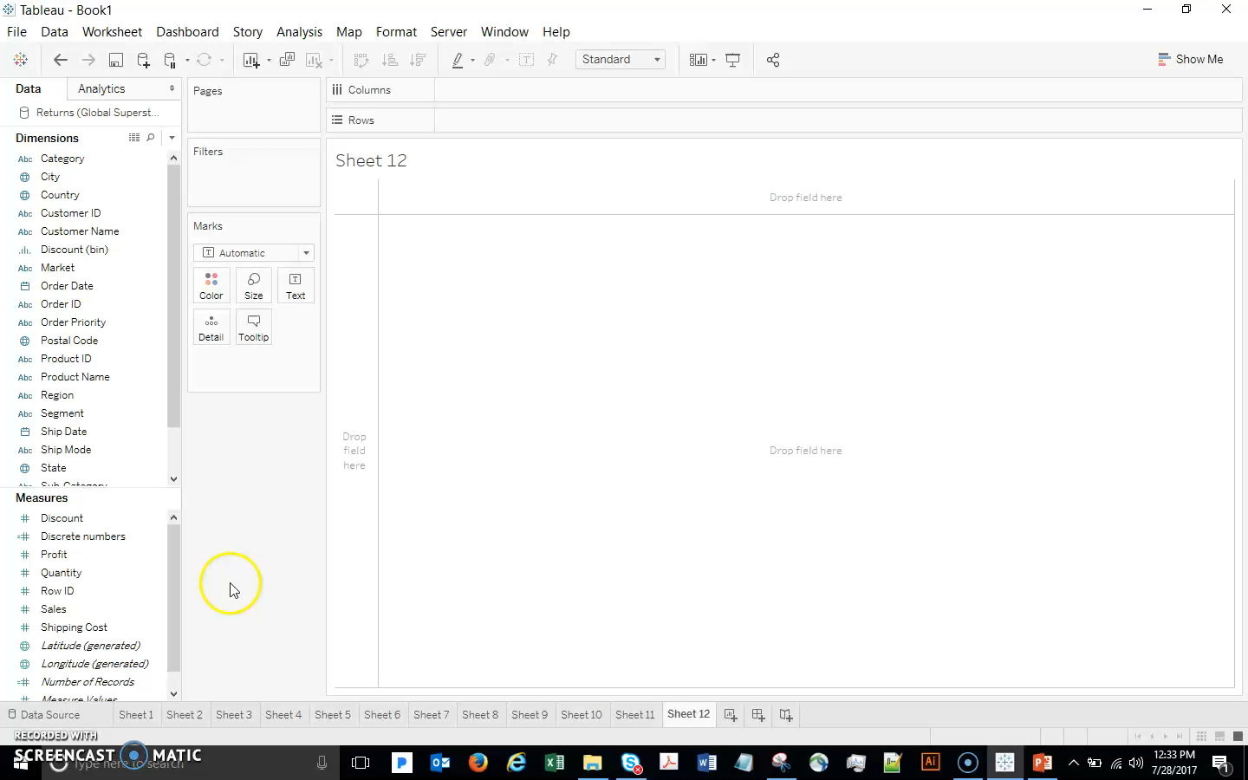
Heat Maps
For the Calculated Field Margin: formula is SUM([Profit])/SUM([Sales])
Notes:
Narration:
Let’s use heat maps to visualize the margin that we are making on Furniture items. Notice that margin is not in the data - let’s do a quick preview of Calculated Fields to create the margin field :
Analysis…Create Calculated Field. Name it Margin, formula is SUM([Profit])/SUM([Sales])
Drag Category and Subcategory to Row
Drag Order Date to Columns, and then change to Month (discrete)
Drag Category to Filter shelf, and select only Furniture
Finally, drag your new Margin field to the viz.
We have a table of numbers. Not the most user-friendly…
Select Heat Map from Show Me, and
then drag AGG(Margin) on the Marks card to Color.
Change color to Orange-Blue Diverging. Drag edges if needed to make the viz larger.
This is much better than the table of numbers! We immediately see some insights – e.g. maybe we are selling tables as a loss leader and making it up on chairs?
Tree Maps:
http://onlinehelp.tableau.com/current/pro/online/mac/en-us/buildexamples_treemap.html
Bullet Graphs
http://onlinehelp.tableau.com/current/pro/online/mac/en-us/help.html#qs_bullet_graphs.html?Highlight=bullet

Slide 26
Heat Maps
Analysis…Create Calculated Field.
Name it Margin, formula is SUM([Profit])/SUM([Sales])
Drag Category and Subcategory to Row
Drag Order Date to Columns, and then change to Month (discrete)
Drag Category to Filter shelf, and select only Furniture
Select Heat Map from Show Me, and
then drag AGG(Margin) on the Marks card to Color.
Change color to Orange-Blue Diverging. Drag edges if needed to make the viz larger.

Slide 27
Other Types of Graphs
Tree Maps:
http://onlinehelp.tableau.com/current/pro/online/mac/en-us/buildexamples_treemap.html
Bullet Graphs
http://onlinehelp.tableau.com/current/pro/online/mac/en-us/help.html#qs_bullet_graphs.html?Highlight=bullet

Slide 28
Control Charts
Notes:
Section Header

Slide 29
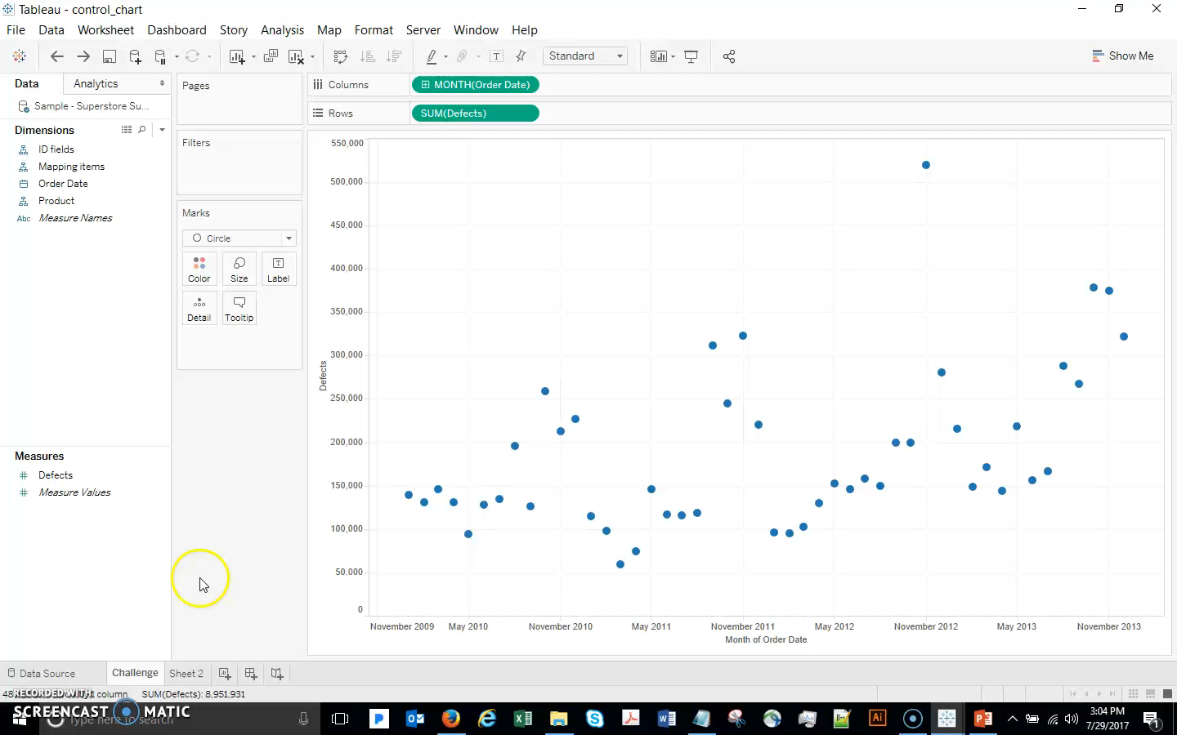
Control Charts - 1
“Lower Band” = WINDOW_AVG(SUM([Defects])-WINDOW_STDEV (SUM ([Defects]) * [Standard Deviations]))
“Upper Band” = WINDOW_AVG(SUM([Defects]) + (WINDOW_STDEV(SUM([Defects]) * [Standard Deviations]))
Notes:
Narration:
For Control Charts, we will introduce the concept of Parameter Controls
Create a parameter named “Standard Deviations” (integer with allowable range 1-6), click drop-down and Show Parameter Control
Create the standard deviation lines using calculations:
“Lower Band” = WINDOW_AVG(SUM([Defects])-WINDOW_STDEV (SUM ([Defects]) * [Standard Deviations]))
“Upper Band” = WINDOW_AVG(SUM([Defects]) + (WINDOW_STDEV(SUM([Defects]) * [Standard Deviations]))

Slide 30
Control Charts – 1 Steps
Create a parameter named “Standard Deviations” (integer with allowable range 1-6), click drop-down and Show Parameter Control
Create the standard deviation lines using calculations:
“Lower Band” = WINDOW_AVG(SUM([Defects])-WINDOW_STDEV (SUM ([Defects]) * [Standard Deviations]))
“Upper Band” = WINDOW_AVG(SUM([Defects]) + (WINDOW_STDEV(SUM([Defects]) * [Standard Deviations]))

Slide 31
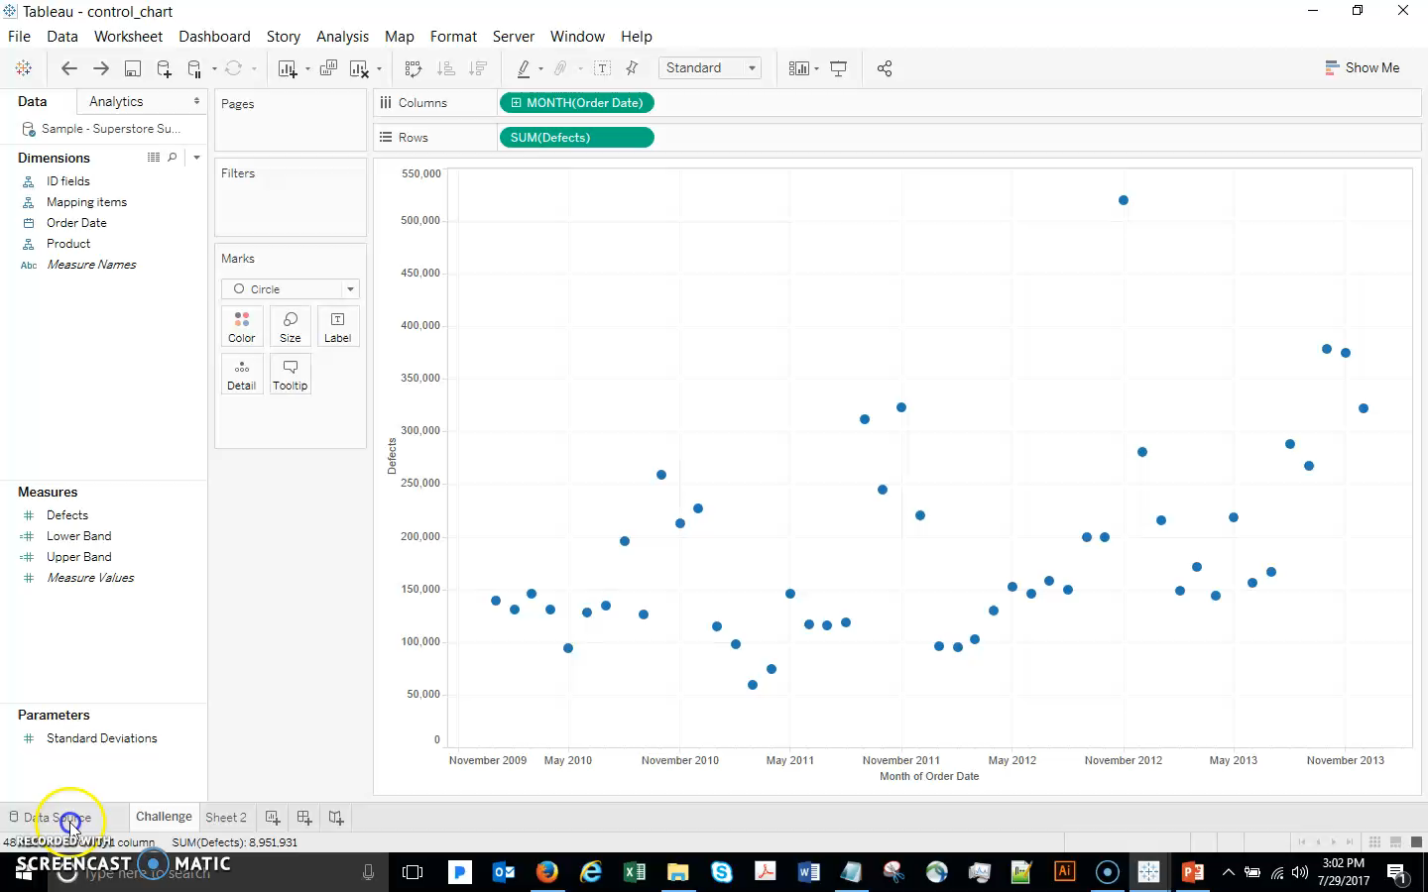
Control Charts

Slide 32
Control Charts
Add both of the bands to a dual axis by dragging them to the right side of the viz. Change their mark types to Line.
Double-click right axis and check Synchronize Axes

Slide 33
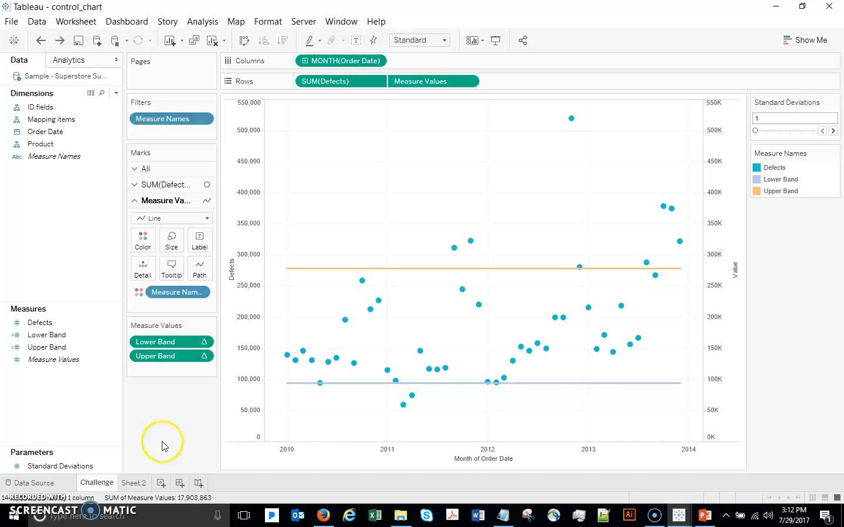
Control Charts

Slide 34
Control Charts
Create a calculated field to mark any point above or below the bands as an outlier:
“Outliers” = SUM([Defects]) > [Upper Band] OR SUM([Defects]) < [Lower Band]
Add the Outliers to color on the defects marks card
Change standard deviation slider and note changes in outlier identification!

Slide 35
Data Science for Business Decisions

